Slide 1
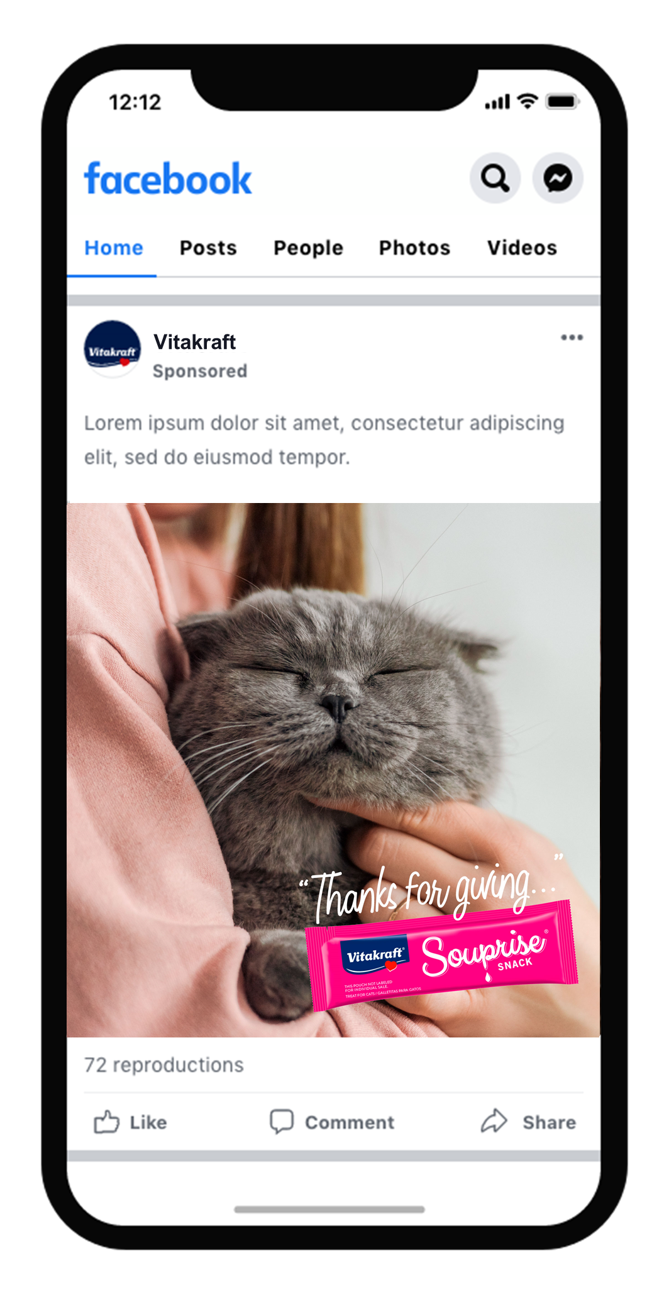
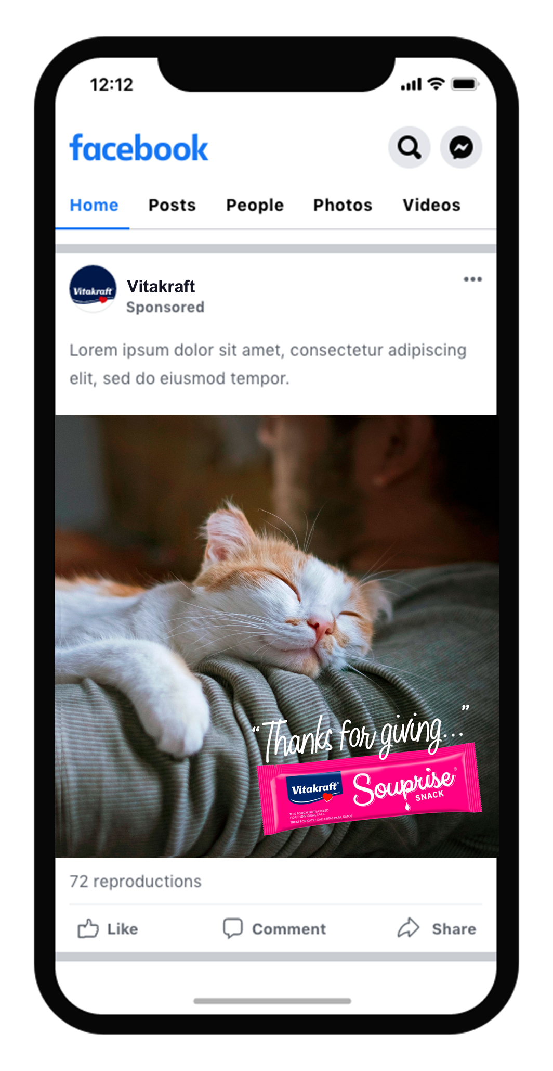
Thanksgiving Campaign
Facebook Posts
Facebook Videos

